Slide 1


Slide 2



Vs
Uva Wellassa University of Sri lanka
Sabaragamuwa University of Sri Lanka

Slide 3




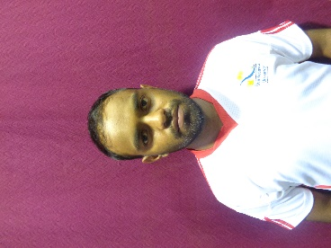
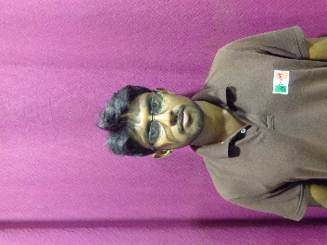
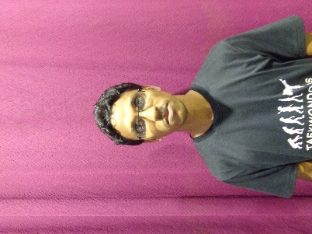
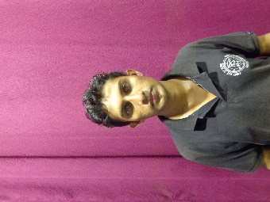
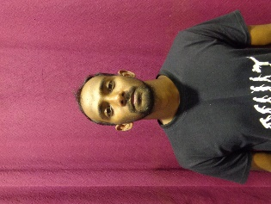
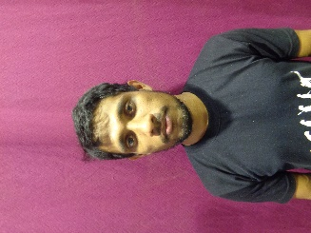
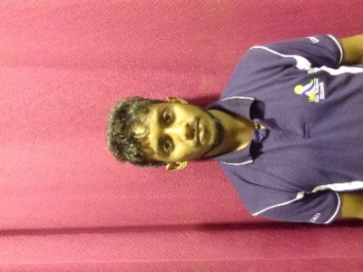
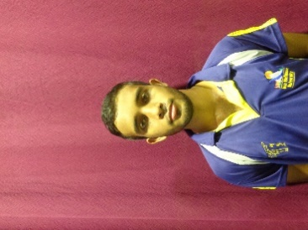
Uva Wellassa university of Sri Lanka
Weigh Class : 54 - 67 Kg
W.N.K.M.S. Danawardana
W.G.T.T.K. Dewasurendara
A.M.N. Jayantha
W.B.M.W.P.K. Weerasekara
T.P.S. Madusanka
A.C.S. Chandrasena
W.H.T.P. Weerapura
M.W.D. Jayasanka

Slide 4
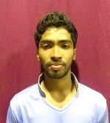
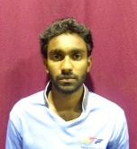
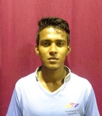
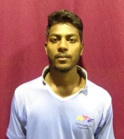
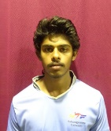
Sabaragamuwa University of Sri Lanka
Weigh Class : 54 - 67 Kg
W.P.N.T. Lakmal
W.N.K.S.I. Dhanawardana
S.M.D.P. Dasanayake
A.M. Darshana
R.V.A.J.Sampath

